Slide 1

Naufar Time Attendance System

Slide 2
PREAMBLE
Followings are some modules outcomes from the SOW sent by the Naufar. The system is defined modules –wise to make it more explicable. Also they are defined and tried to explore more from the technical point.
New modules and definitions shall be added after taking the actual study of the system. And the system shall be customized accordingly.

Slide 3
System shall be based on
Secure–Framework based
SQL Server – Backend
Roles based system
Integrated with SAP
Roster equipped
Dashboards for each user

Slide 4
[ adding state defined holidays ]
Approved Holiday Calendar
Approved Off-Day Calendar
[ adding Naufar defined holidays ]

Slide 5
Cadre Management
Designation Management
[ adding major cadre like Medical, Clinical, Non Medical etc ]
[ like, Medical Officer, Nurse, OT Attendant etc ]
[ each designation will go under its separate cadre ]

Slide 6
Employee Management
[Information required for adding an Employee]
Basic profile
Contact
Unit to work [where he/she is authorized]
Skills [ Skills are necessary along with each employee as during shift assignment the Shift Creator will look to the skills of staff and then assign duty accordingly ]
Availability Calendar

Slide 7
Team Management
[ for 8 hours shift management there are total of 4 team shall be require to provide 24/7 cover]
[A Team (AT), B Team (BT), C Team (CT), D Team (DT) ]

Slide 8
Shift Assignment Reason
[ Adding categories like ]
Normal Shift Assignment
Special Shift Assignment
Extra Shift Assignment

Slide 9
Time Off Request Management
[ staff members when request for time off, they will sign a form request, and system shall record the same ]

Slide 10
Unit management
[ adding units like OT, Surgical Ward, Emergency ]
[ each unit will have its own unique code like for Emergency the code can be: EMR ]

Slide 11
Leave Management System
[ The system shall add different types of Leaves and calculation as per policy ]
[ adding to system employee’s approved leave record ]

Slide 12
Time in lieu of Over-time:
[time off work ]
[ system shall compensate employees who are required and approved to work outside their ordinary start and finish times or in excess of their ordinary hours of duty i.e. overtime ]
Ref: SOW: page.09 pt.22
[ employees after login to system as staff member can view overtime, time in lieu calculations, attendance, leave records etc ]

Slide 13
Shift Swap / Shift Trade
[ def:– process whereby two or more employees request approval from their Manager to swap shifts. This process occurs after a roster has been developed and published ]
[ when swap is confirmed system shall generate and email to corresponding shift manager ]
Ref: SOW: page.09 pt.12
[ shift supervisors shall approve the swapping to make effect ]

Slide 14
Rotating Shift Rosters Management
Ref:SOW: page.09 pt.7
1- Morning Shift (M) : 06:00AM - 14:00PM
2- Evening Shift (E) : 14:00PM - 22:00PM
3- Night Shift(N) : 22:00PM - 06:00AM

Slide 15
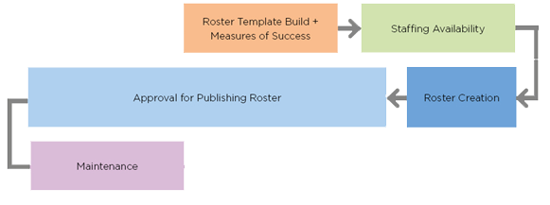
Shift Process

Slide 16
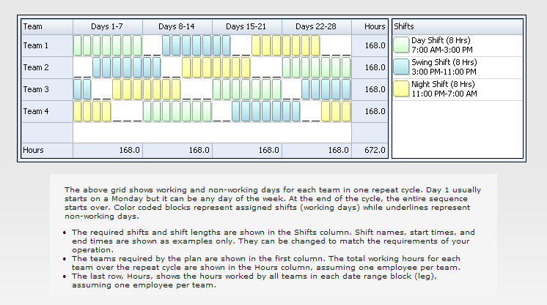
Shift Pattern

Slide 17
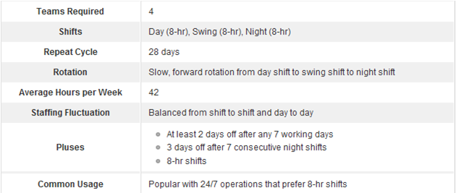
Shift Pattern Details

Slide 18
Other features
Shift Clone
Breaks Management
Reports

Slide 19
Policy Points
First
Second
Last
The shift administrative staff shall be as per system defined roles
Ref: SOW: page.09 pt.14
Shift creator will add information regarding 1st on call and 2nd on call
Ref: SOW: page.09 pt.16, 23
Each unit head (shift creator) will prepare the rosters/shifts for his/her unit
Ref: SOW: page.09 pt.01
Split shift for Ramadan: Shift creator while creating shift can mention break timings for Iftari and Sehri with adjustments
Ref: SOW: page.09 pt.07
.

Slide 20
“ Important thing “
Separate shift rosters the system shall maintain /manage/create for each cadre of staff [like nursing staff, medical staff or teaching staff] belonging to separate Units. Ref: SOW: page.09 pt.15

Slide 21
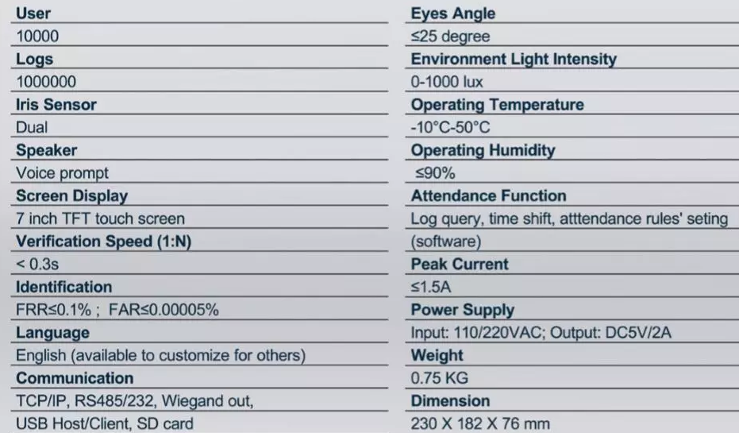
MULTI-MEDIA TIME ATTENDANCE BASED ON IRIS TECHNOLOGY.

Slide 22

Thanks!
Any questions?

